Slide 1
Key words of chapter 28
Magnetic dipole 磁偶极子
Crossed field 混合场
Hall effect 霍尔效应
Number density 数密度
Electromagnet 电磁铁
Cyclotron 回旋加速器
Synchrotron 同步加速器
Helical paths 螺旋路径
Magnetic dipole moment 磁偶极矩
Coil 线圈
Orientation energy 方向能

Slide 2
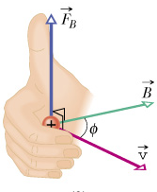
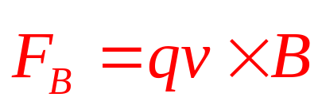
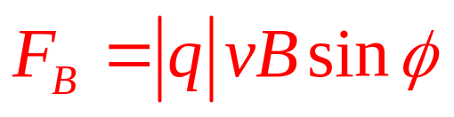
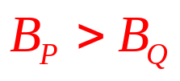
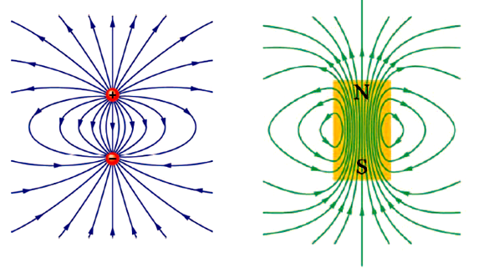


Review of Ch28
Magnetic force and Magnetic field lines
Q
P
magnetic field lines
Notes:
The magnetic force on a moving charge immersed in a B field is described by this equation, where v is the velocity of the particle, q is the charge of the particle, it can be a negative or positive.
Using right hand rule, use your right hand, curve your four fingers from v over the smaller angle to vector B, if Q is positive, the stretched thumb points the direction of F, otherwise, the stretched thumb is opposite the direction of F.
because the force is always perpendicular to the plane determined by v and B, so the power if magnetic force F.v is always 0, the magnetic force always does no work.
Keep in mind, The magnetic field lines form a closed loop.

Slide 3

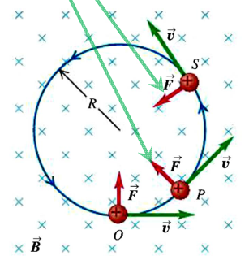

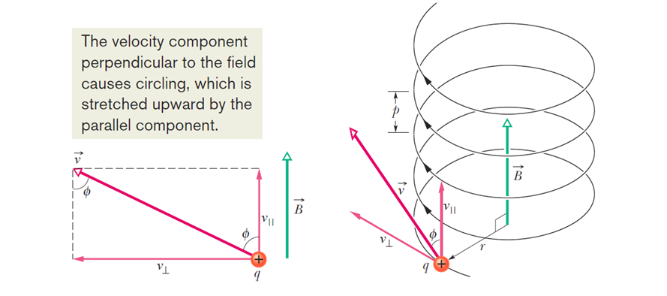
Review of Ch28
Moving charge in B-Field
Circular motion
Helical motion
Notes:
If v is perpendicular to uniform B field, then the charged particle is in the uniform circular motion, and the magnetic force is just the centripetal force.
Keep in mind here, the period of this circular motion does not depend on v, it’s key to the operation of cyclotron.
If v makes an angle with the uniform B field, then we can decompose v into parallel component and perpendicular component, for the perpendicular component, it’s just in a circular motion. And for the parallel component, there’s no force, it’s just a constant velocity motion. We call the compound motion as the helical motion, and the distance between two adjacent circle is pitch p
P= v//*T

Slide 4
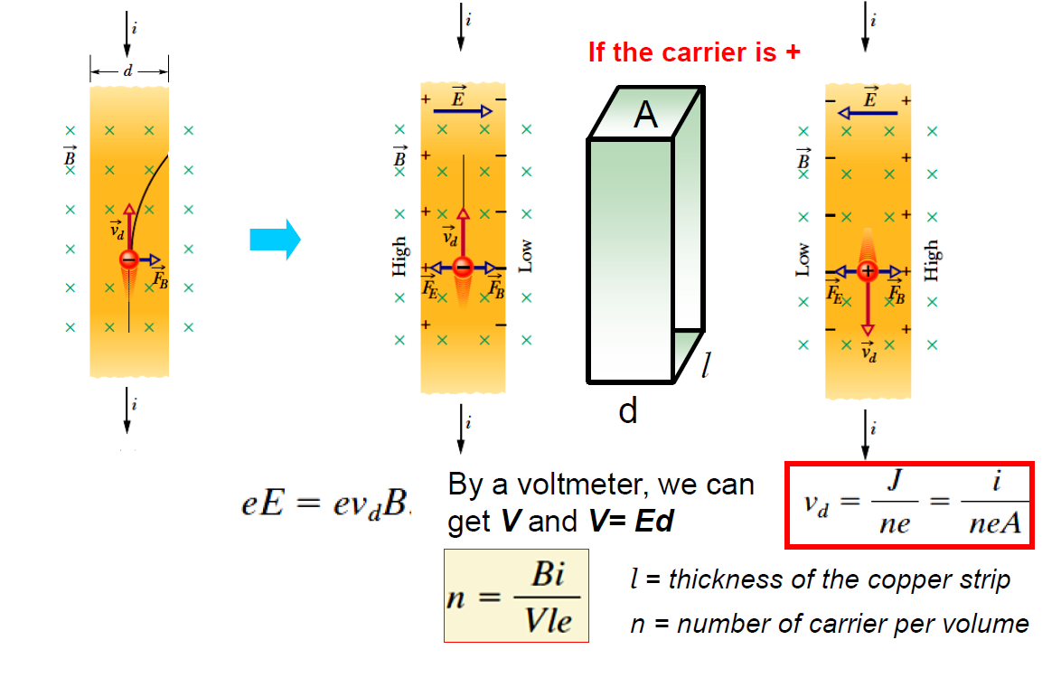
Review of Ch28
Moving charge in crossed field
Moving in Crossed field (E-field and B-field):
Notes:
If a copper strip carrying a current i is immersed in a uniform magnetic field, then the electrons inside the copper have a drift velocity, so each electron feels a magnetic force F.
this I is downward, so v of the moving electron is upward, so the magnetic force direct to rightward, the electrons accumulated at the right side, leaving the proton stay at left side, the separation of the positive charges and negative charges produce a E field pointing from left to right, and this E field exert a static force on the electron which oppose the magnetic force, until the two force balance, a new equilibrium is reached. The potential caused by the E field then reaches its maximum constant value. Combine those two equations, we can get n, the number density of the charge carries. So fundamentally, the hall effect comes from the magnetic force on the moving charge carries. For the same I, same B, different charge carries obtain opposite potential difference, so by using this property, we can identify the polarity of the charge carries.

Slide 5
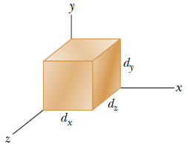
Problem of Ch28
Problem 1
A metallic block, with its faces parallel to coordinate axes. The block is in a uniform magnetic field of magnitude B=0.020 T. One edge length of the block is 25 cm; the block is not drawn to scale.
The block is moved at 3.0 m/s parallel to each axis, in turn, and the resulting potential difference V that appears across the block is measured. With the motion parallel to the y axis, V=12 mV; with the motion parallel to the z axis, V=18 mV; with the motion parallel to the x axis, V=0.What are the block lengths (a) d_{x}, (b) d_{y}, and (c) d_{z}?
Notes:
If we move the metallic block, the electrons inside it must move with it. The moving electron with velocity v moves through the B field, so a magnetic force exert on it.
The electrons accumulate at one side and leaving the proton at the other side, this separation produce a E field, as well as a potential difference. If the potential difference is 0, that means the electron does not move from one side to the other side during its moving along the block, so F = 0 , so v must be parallel to B, then we know the direction of B field.
If the electrons moves along y axis, the magnetic force must be along z direction, so the E field

Slide 6
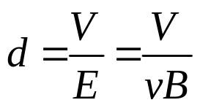
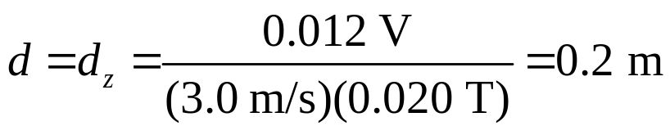

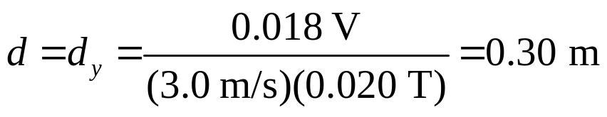
Problem of Ch28
Problem 1
with the motion parallel to the x axis, V=0, So B must be along the x axis
Thus, our answers are
(a) d_{x} = 25 cm
which we arrive at “by elimination,” since we already have figured out d_{y} and d_{z}
(b) d_{y} = 30 cm
(c) d_{z} = 20 cm.

Slide 7
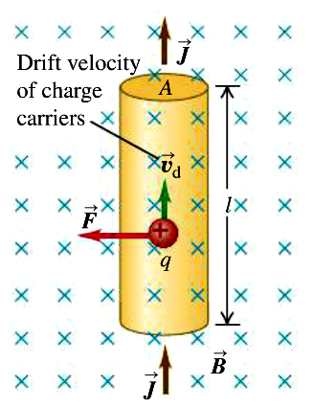
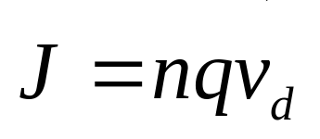




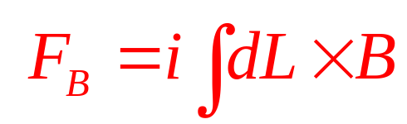


Review of Ch28
Magnetic force
.
i
Notes:
The magnetic force on a straight current carrying wire immersed in a uniform magnetic field is this . For the curved wire of un-uniform B field case , we have to use integration to calculate F.
For uniform B, but a curved current carrying wire, we use this integration, because B is a constant, so we can take it out of the integration, then it becomes
It’s clearly ,if we have a current loop, then the net force on the loop due to the B field must be 0.

Slide 8
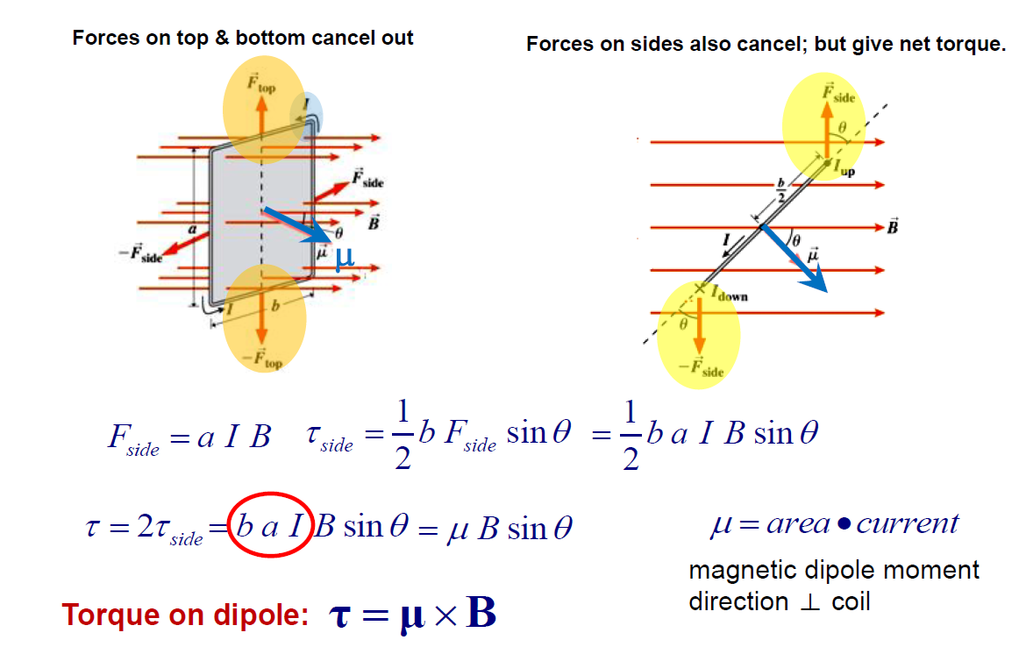
Review of Ch28
Magnetic dipole moment
The right hand rule determines the direction of the magnetic moment
Notes:
Even the net force on this loop wire is 0, but a net torque indeed exert on it, we can use this equation to calculate it directly.

Slide 9
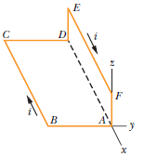
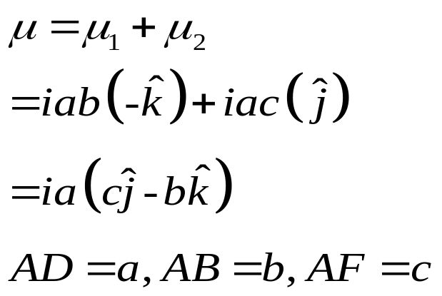
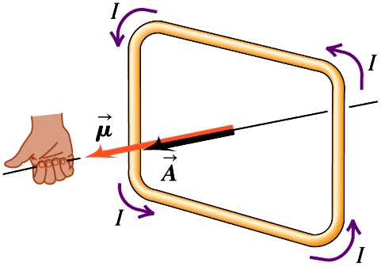
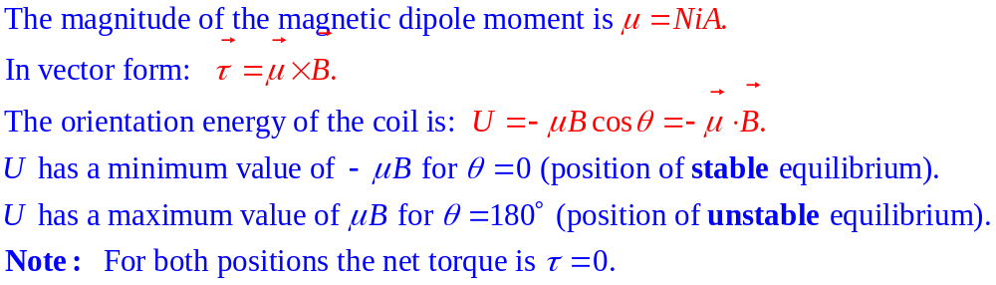
Review of Ch28
Magnetic dipole moment
The right hand rule determines the direction of the magnetic moment
Notes:
a current loop, a coil, is so called magnetic dipole and u is the magnetic dipole moment of the coil, the magnitude of u is NiA, the direction of u is determined by right hand rule, use your right hand, and grasp the coil and let your four fingers point to the current, and your thumb points to u.
If we know u , B then we know the torque on the coil due to B field.
The u is a vector, it also obeys the law of superposition, let’s look at example, if we have this coil, it can be considered as a combine of two coils, one is ABCD, the u of this coil is,
the other is DEFA, the u of this coil is ---
The sum of the them is the dipole moment for the whole coil ABCDEF.

Slide 10
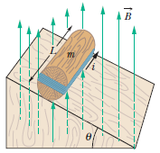
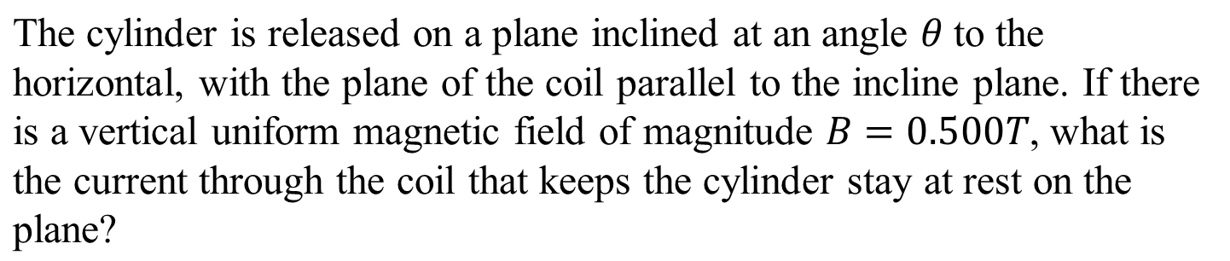
Problem of Ch28
Problem 2
A wood cylinder of mass m=0.250 kg and length L=0.100 m, with N=10.0 turns of wire wrapped around it longitudinally, so that the plane of the wire coil contains the long central axis of the cylinder.
Notes:
This is about static equilibrium, for static equilibrium, we have two equilibrium conditions:
For translational motion, the net force on the cylinder must be 0, for rotational motion, the net torque must be 0, so first we should analyze the forces on the cylinder.
N and f from the plane, gravity from the Erath, downward, the net force due to the coils must be 0

Slide 11
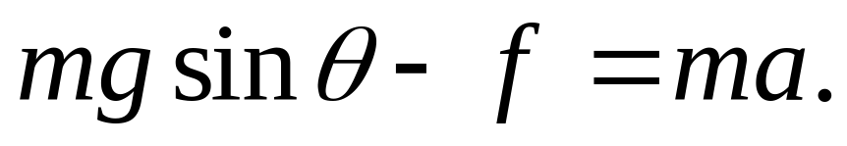
Problem of Ch28
Problem 2
Since the plane of the loop is parallel to the incline the dipole moment is normal to the incline. The forces acting on the cylinder are the force of gravity mg, acting downward from the center of mass, the normal force of the incline F_{N}, acting perpendicularly to the incline through the center of mass, and the force of friction f, acting up the incline at the point of contact. We take the x axis to be positive down the incline. Then the x component of Newton’s second law for the center of mass yields

Slide 12
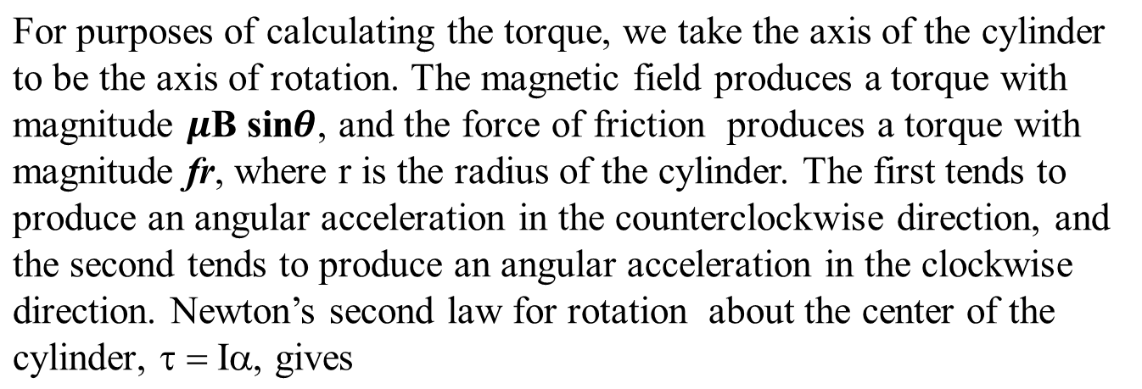
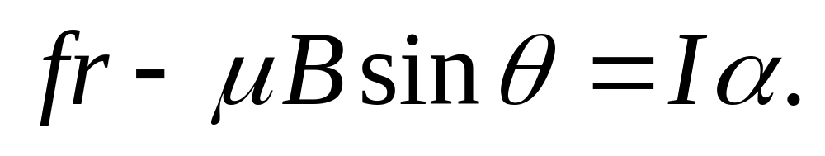
Problem of Ch28
Problem 2

Slide 13
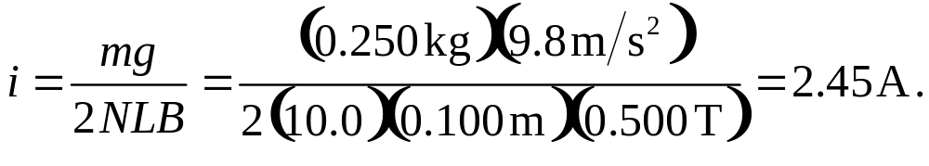
Problem of Ch28
Problem 2
Since we want the current that holds the cylinder in place, we set a = 0 and α = 0, and use one equation to eliminate f from the other. The result is The loop is rectangular with two sides of length L and two of length 2r, so its area is A = 2rL and the dipole moment is Thus, and

